Slide 1

Time Series
What and Why
Dr. Abolfazl Saghafi
Assistant Professor of Statistics & Data Science
Notes:
Hello and welcome to this course on Time Series and Forecasting. I am Abolfazl Saghafi, Assistant Professor of Statistics & Data Science in University of Sciences, and I’m super excited to guide you through this subject

Slide 2
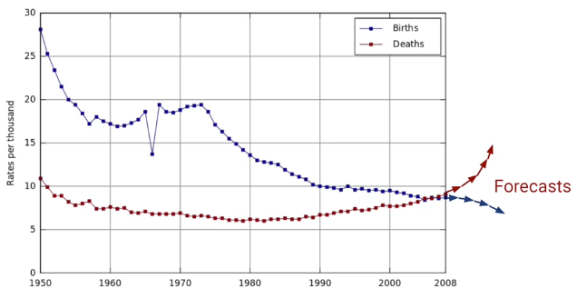
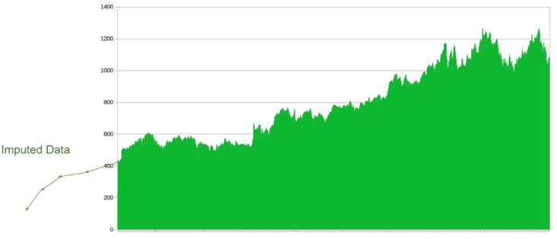
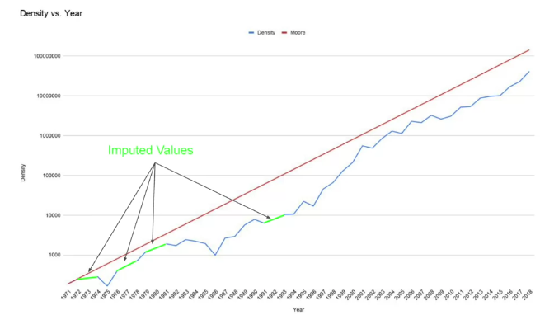
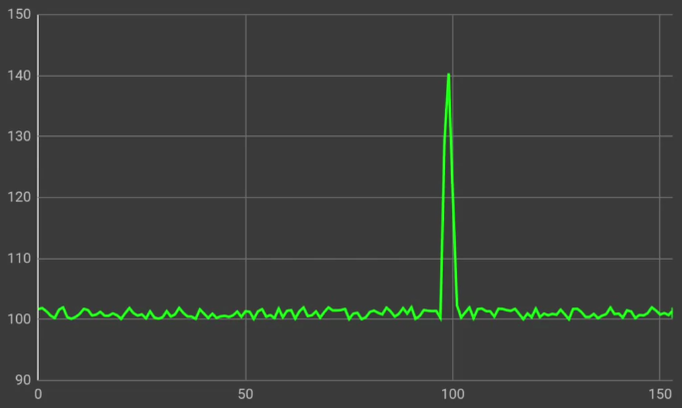
Time Series
Time series are a collection of observations gathered sequentially through time.
Some reasons to study Time Series include:
• To Forecast
• To Impute
• To Detect Anomalies
Notes:
Lets start with, what Time Series are. Time series are observations, gathered through time. Everything we do is a function of time, applications range from economics to engineering.
Some motivations to study Time Series are, first and most importantly, to forecast. We all are curious by nature about future, whether it’s whether forecasts, or future prices of a stock market. If you’re REALLY good at this, you can make a fortune out this. Imputation is another reason, where we want to understand what happened in the past, given current observations. Or simply filling out the gaps between what is observed. To detect anomalies is another big reason. For example, to detect unauthorized or high value purchases.

Slide 3
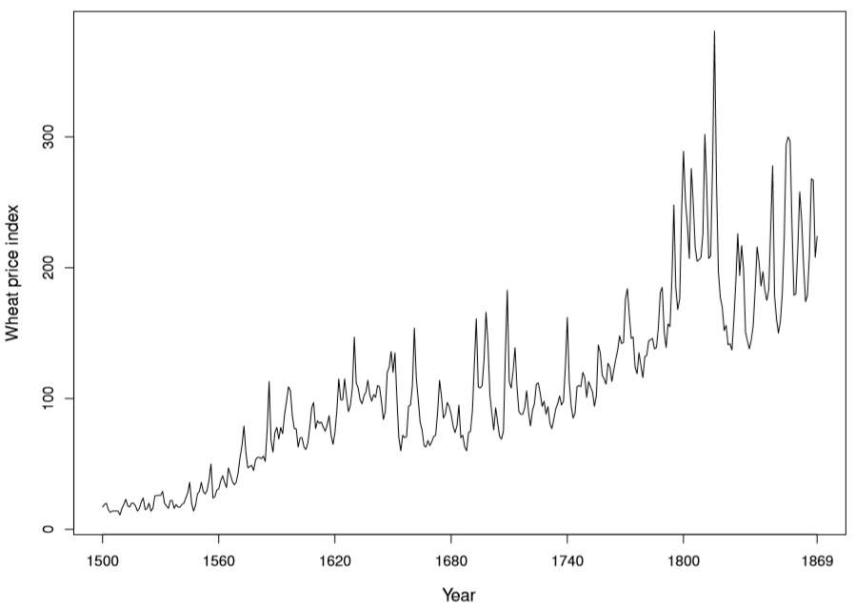
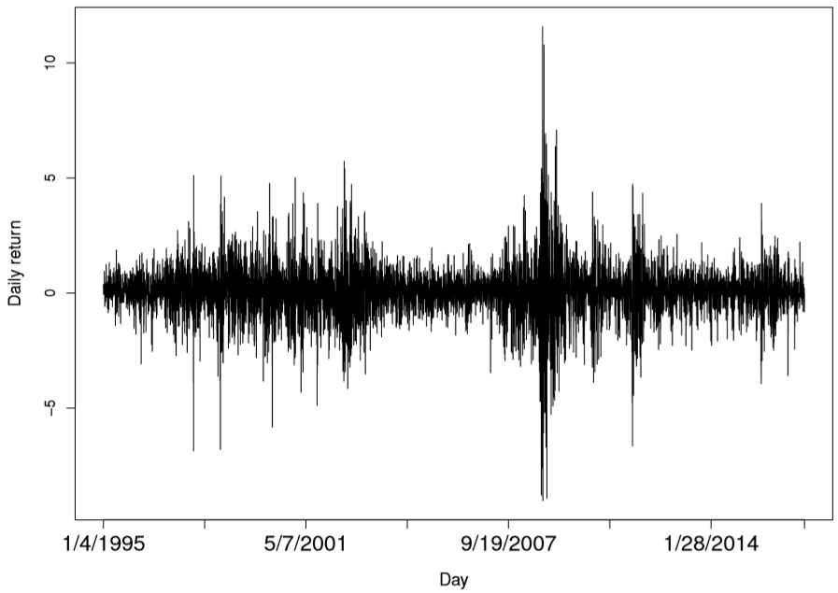
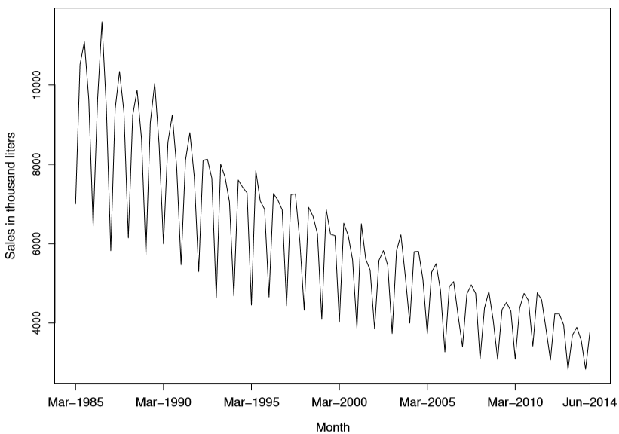
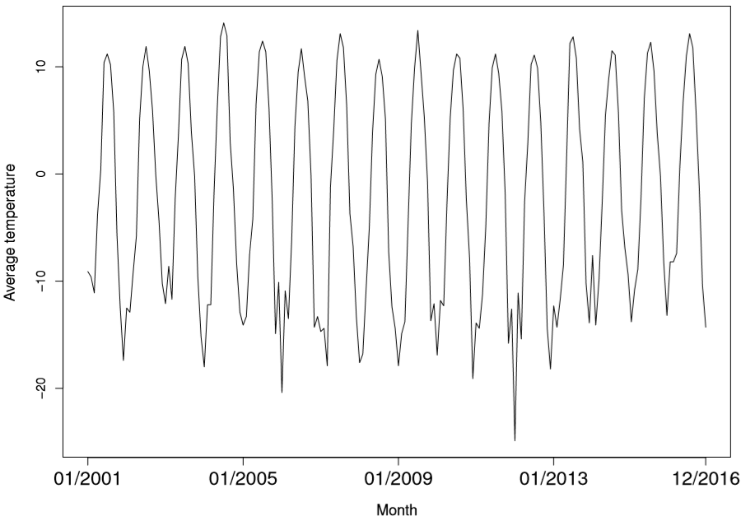
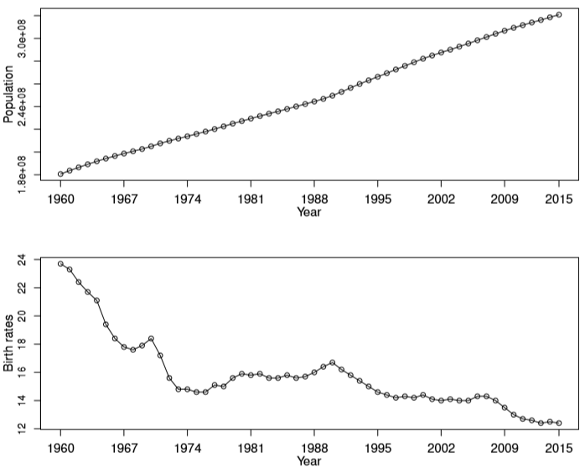
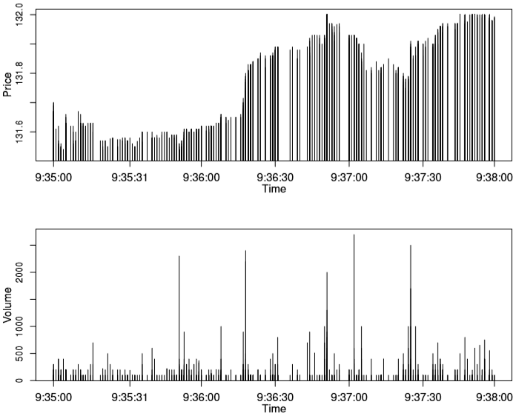
Time Plot
The ﬁrst, and most important, step in any time-series analysis is to plot the observations against time.
This graph, called a time plot, will show up important features of the series such as trend, seasonality, outliers and discontinuities.
Notes:
The ﬁrst, and most important, step in any time-series analysis is to plot the observations against time. This graph that is called the Time Plot, reveals important features in the data such as trend, seasonality, outliers and discontinuities.
Here are some examples of Real Time Series, see if you can detect these features, try to describe what you see, I’ll give a few seconds before adding my thoughts.
For example, Beveridge wheat price annual index from 1500 to 1869, where we can see some apparent cyclic behavior and a general upward trend.
Daily returns of adjusted closing prices of the S&P500 index from January 4, 1995 to December 30, 2016. This is a typical return data. The mean return seems to be stable with an average return of approximately zero, but the volatility changes over time.
Monthly average air temperature (deg C) in Anchorage, Alaska, United States, from 2001 to 2016. Domestic sales (in thousand liters) of Australian fortiﬁed wine by winemakers in successive quarters from March 1985 to June 2014. Total population and birth rate (per 1,000 people) for the United States from 1965 to 2015. And Transaction prices and volumes of IBM stocks from 9:35:00 to 9:38:00 on January 4, 2010.

Slide 4
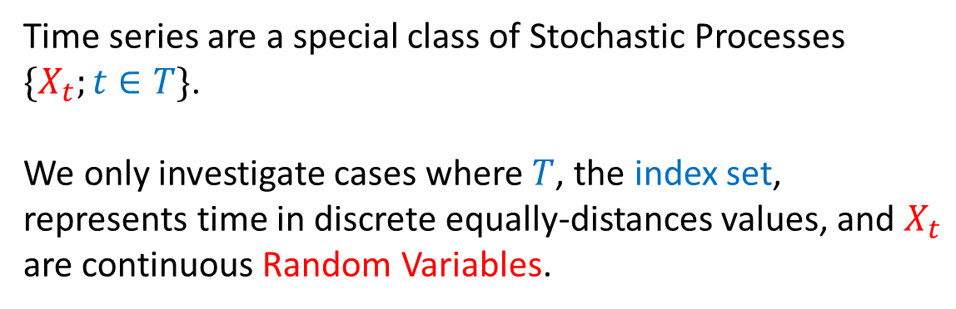
Time Series and Stochastic Processes
Assumptions:
● Time index is discrete and equally-distances values
● The measurement variable is continuous
Time series are a special class of Stochastic Processes $\{X_{t};t∈T\}$.
We only investigate cases where $T$, the index set, represents time in discrete equally-distances values, and $X_{t}$ are continuous Random Variables.
Objectives:
● Description
● Explanation
● Forecast/Impute
● Detect/Control
There are several possible objectives in analyzing a time series. They may be classiﬁed as description, explanation, forecast/impute, and detect/control. These will be considered in turn.
Don’t be hesitant in trying different ideas to see what works best.

Slide 5
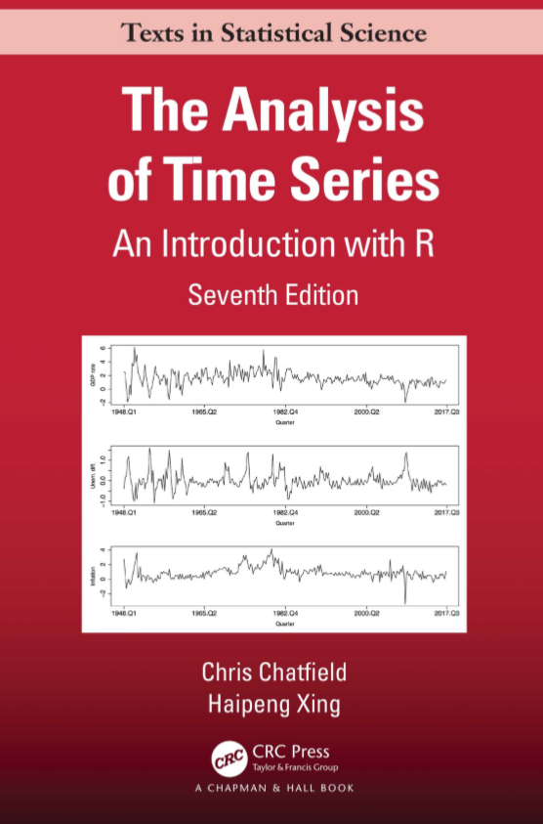
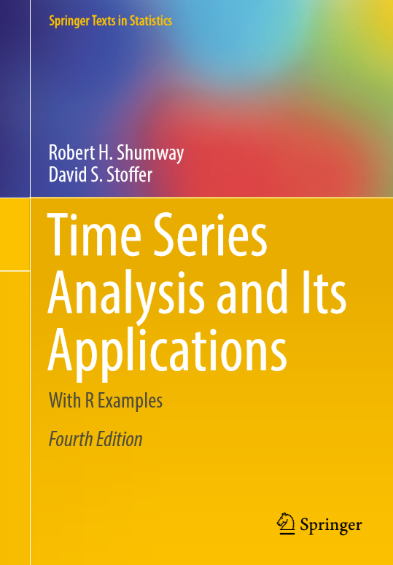
Textbook
Office: STC 209
Email: A[DOT]Saghafi[At]USciences.edu
Office Hours: See Syllabus (email me prior)
Mastering what you learn in this course and being able to apply them requires reading the material, writing the math parts, and practicing coding.
Notes:
Mastering what you learn in this course and being able to apply them requires reading the material, writing the math parts, and practicing coding. My recommendation is to purchase this textbook, that is The Analysis of Time Series with R by Chatfield & Xing.
We will cover subjects discussed in this book, I will provide PowerPoint handouts that include summary of discussed subjects and practice problems. If you’d like to practice more, I recommend this second textbook, Time Series Analysis and Its Application with R Examples, by Shumway & Stoffer.

Slide 6


Technology
We will be using R in this course. Chapter codes will be provided along with lectures. You will need to install R Markdown package, since homework assignments should be written in R Markdown. Some instructions are available as handouts on D2L.
PRACTICE CODING
It might take you some time to figure out what each part of the code does and to write, troubleshoot your codes. This is a time well-spent.
GOOGLE
Find alternate way of solving a problem by googling and finding out other codes. Make a repository for yourself. Comment on your codes so you remember what you did when you did it.
Notes:
We will be using R in this course. Chapter codes will be provided along with lectures. You will need to install R Markdown package, since homework assignments should be written in R Markdown. Some instructions are available as handouts on D2L.
You don’t have to be a professional coder to start and pass this course successfully and most importantly, you don’t have to memorize codes discussed in the course. Create a archive of codes and what you learn, so that you can access them easily whenever you needed to. Eventually you’ll master the coding. If you do something five times, it becomes yours, make the codes yours.
With this being said, lets start the journey!

Slide 7
Time Series Components & Stationarity
Dr. Abolfazl Saghafi
Assistant Professor of Statistics & Data Science
Notes:
Descriptive methods should generally be used before attempting more complicated procedures. They can be vital in cleaning the data and getting a better feel of the numbers, before trying to generate ideas as regards to a suitable model. These descriptive methods are different from computing mean and standard deviation that are typically considered with other datasets.
In this session we review some of theses basic subjects that are suitable for Time Series data

Slide 8
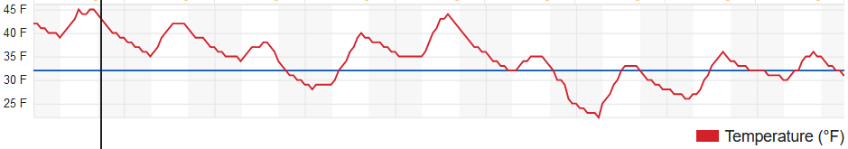
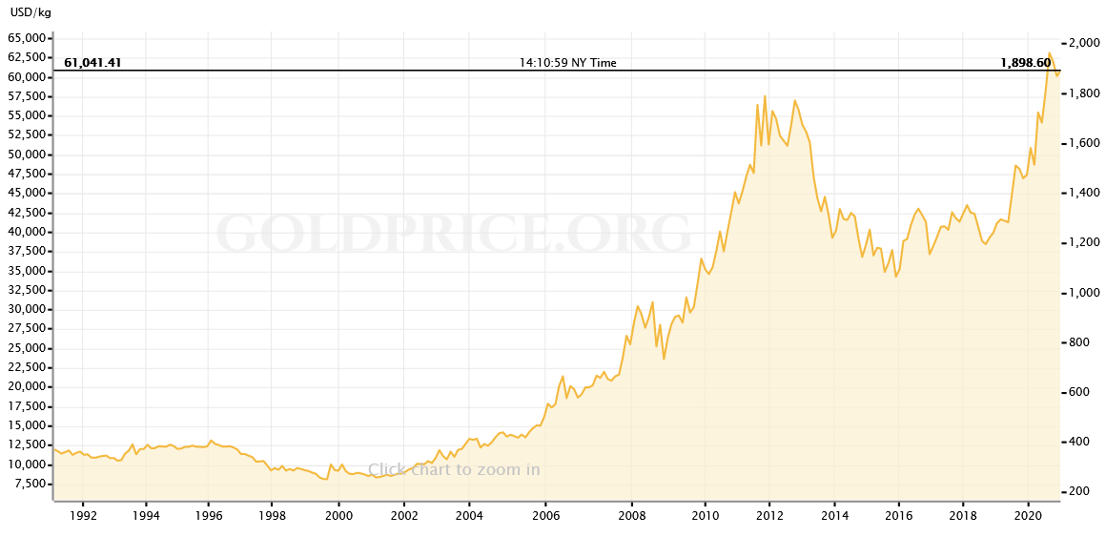
Seasonal and Cyclic Variations
1. Seasonal Variation: Many time series, such as sales ﬁgures and temperature readings, exhibit variations that are cyclic. Theses cycles could be seasonally, monthly, etc.
*Other Periodic Variations: Some time series exhibit cyclic variations at a shorter time interval. An example is daily variation in temperature.
Some cyclic variations take much longer, for example in economic data, that are sometimes thought to be aﬀected by business cycles with a period varying from 3 years to more than 10 years.
Notes:
Monthly average air temperature (deg C) in Anchorage, Alaska, United States, from 2001 to 2016.

Slide 9
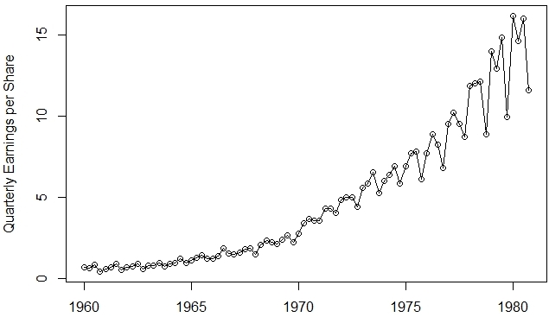
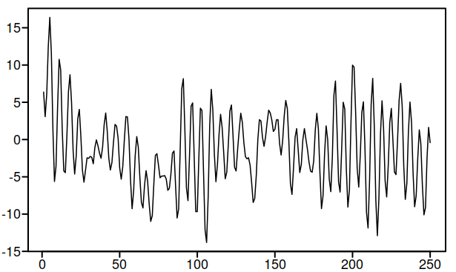
Trend and Other Variations
2. Trend Variation: Trend is the long-term change in the mean level, taking into account the number of observations available.
3,4. Other Fluctuations: Once trend and seasonal variations have been removed from a set of data, we are left with a series of residuals that may or may not be random.
We will examine various techniques for analyzing series of this type, either to see whether any cyclic variation still exists in the time series, or whether apparently irregular variation may be explained in terms of some probability models.
Notes:
Looking at quarterly earnings, there exist an upward trend, that is the mean of the observations increases in time. This trend here seems to be quadratic or exponential, in general, it can be in many forms.
Looking at the second chart, the mean of the series is constant as there are no upward or downward trend. There don’t seem to be any seasonal patterns. The fluctuations seem to be random BUT are they really random?

Slide 10
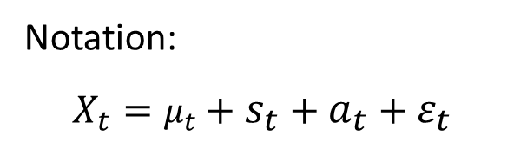
Stationary Time Series
Weak Stationarity:
● No variation in mean
● No variation in variance
● No seasonal variations
A time series is said to be stationary (weak) if there is no systematic change in mean (no trend), and if there is no systematic change in variance, and if there is no seasonal variations.
We will learn how to remove trend and seasonal effects if they exist in a time series to make it stationary.
Then we follow up with modeling
Much of the probability theory of time series is concerned with stationary time series. For this reason time series analysis often requires one to transform a non-stationary series into a stationary one so as to use these theories.
What we discuss is
$$Time Series=Trend+Seasonal Var+Mathematical Var+Random Variation$$
Notation:
$$X_{t}=μ_{t}+s_{t}+a_{t}+ε_{t}$$
Notes:
What we discuss is that we have a time series that is summation of four components, it could have trend, could have seasonal effect, could exist a mathematical patterns behind time series fluctuations, and a random pattern could exist that has been added to all of these.

Slide 11
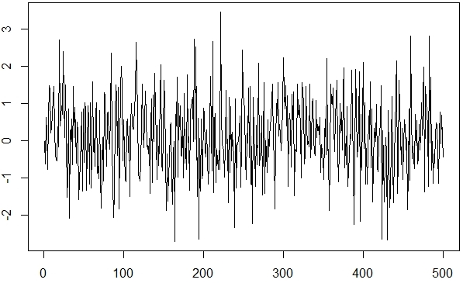
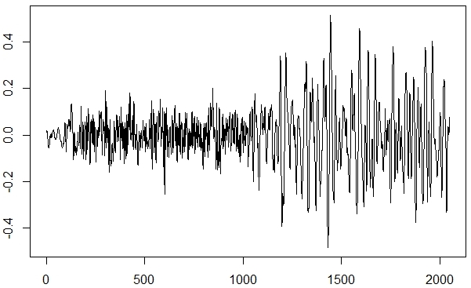
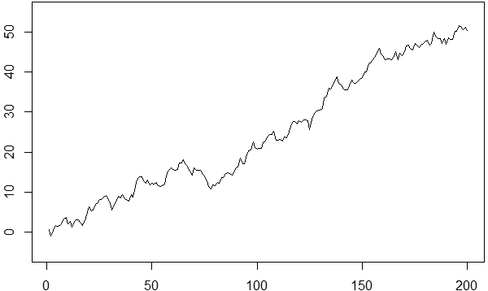
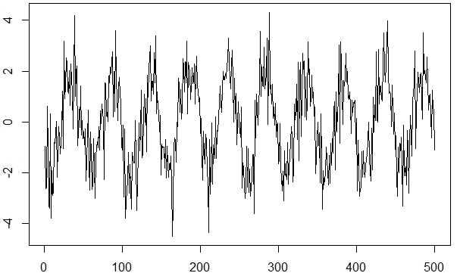
Example
Which of these time series are stationary and which are not. Explain why.
Notes:
Which of these time series are stationary and which are not. Explain why.
Bottom Right: There is an obvious cyclic pattern, so, this is a non-stationary time series. If you divide 500 by 10, that gives us the approximate cyclic frequency.
Bottom Left: This series has an upward trend, so, it is non-stationary.
Top Right: There is no trend here, there is no cyclic effect, but the bandwidth of series increases in time. So, variance is not constant here and the series is non-stationary.
Top left: There is no trend, no seasonal effects, fluctuations seem random, boundary of series does not change through time, so we have a stationary time series.

Slide 12
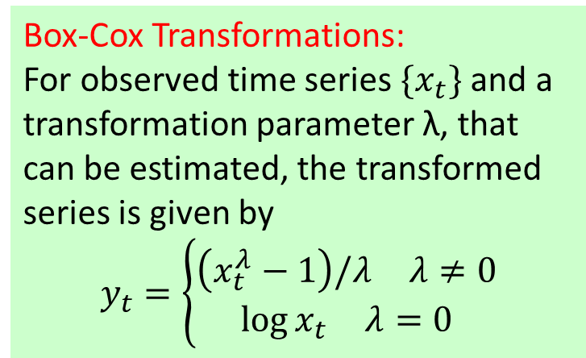

Transformations
Transformations:
● Stabilize Variance
● To achieve normality of residuals
● To make multiplicative seasonal effects additive
Three main reasons for making a transformation are:
(i) To stabilize the variance. If there is a trend in the series and the variance appears to increase with the mean, then it may be advisable to transform the data.
Box-Cox Transformations:
For observed time series $\{x_{t}\}$ and a transformation parameter λ, that can be estimated, the transformed series is given by
$$y_{t}=\left\{\begin{aligned}\begin{matrix}\left(x_{t}^{λ}−1\right)/λ & λ≠0\end{matrix} \\ \begin{matrix}\log{x_{t}} & λ=0\end{matrix}\end{aligned}\right.$$
(ii) To make the data normally distributed. Model building and forecasting are usually carried out on the assumption that the data are normally distributed. Box-Cox transformations helps with this.
(iii) To make the seasonal eﬀect additive. If there is a trend in the series and the size of the seasonal eﬀect appears to increase with the mean, then it may be advisable to transform the data.
$$Log\left(A∗B\right)=Log\left(A\right)+Log\left(B\right)$$

Slide 13
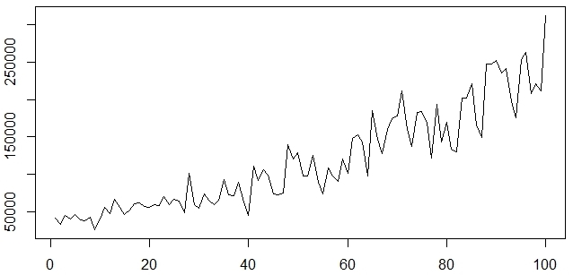
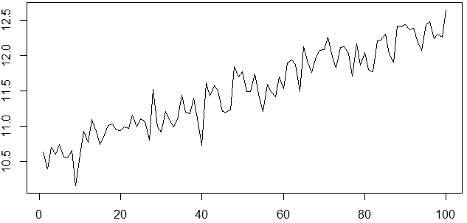
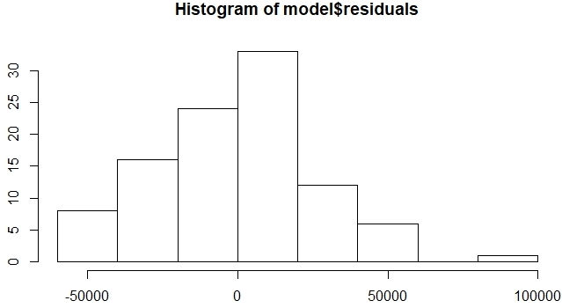
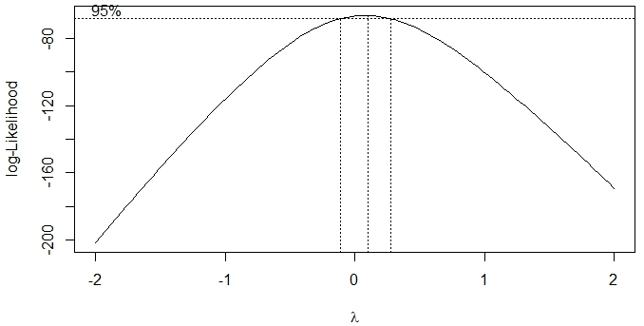
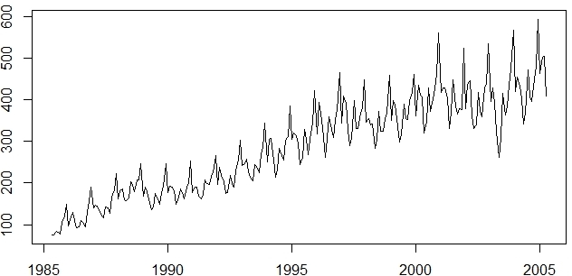
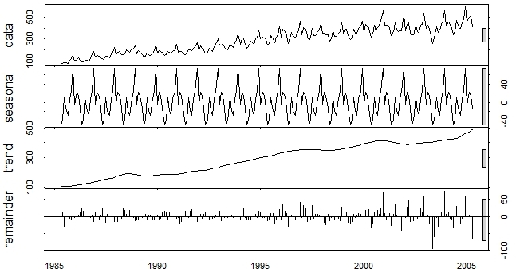

Example
$$⇒$$
Practice these with the provided codes.
Notes:
Top Left: This is a non-stationary time series, there is an upward trend there, plus variation increases in time
Top Right: This is what we get after a log-transformation. You can see that the trend still exists, obviously it’s linear. The variation issue has been fixed here, as the bandwidth of the series seems equal through time.
Middle Left: These are residuals after removing a quadratic trend from the first time plot. You can see that the distribution of the residuals is not normal, they have a skewed distribution.
Middle Right: This is what Box-Cox transformation suggest for the initial time plot. A value of lambda from -0.05 to 0.07. When deciding on the value of lambda, we usually pick a number within the given interval. Here, 0 sounds like a good choice, this value of zero corresponds to a log-transformation if you look at the formula given earlier.
Bottom Left: This time series has a seasonal effect that is multiplied instead of added to the series. The cyclic pattern is obvious sign of seasonal variation. If we decompose this time series into three main components, you can see the seasonal, trend, and random variation. Something is off here, can you detect it? The random variation bandwidth increases in time. A log transformation is recommended for this time series before proceeding to break it into its components.
Bottom Right: This is decomposition plot for time series in bottom left.

Slide 14
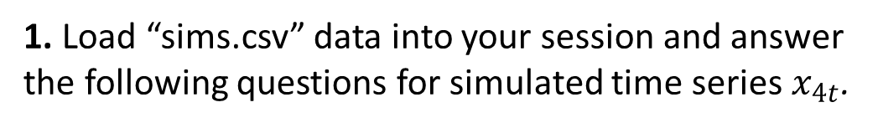
Practice Problems
1. Load “sims.csv” data into your session and answer the following questions for simulated time series $x_{4t}$.
a. Graph a time plot and explain whether the time series is stationary or not.
b. Graph a histogram of $x_{4t}$ and comment on the distribution of data.
c. Explain what transformation could resolve non-stationarity if exist.
d. Perform Box-Cox transformation and a report value for lambda that works best for transforming this data.
e. Graph a decomposition plot and comment on each component of the plot.

Slide 15
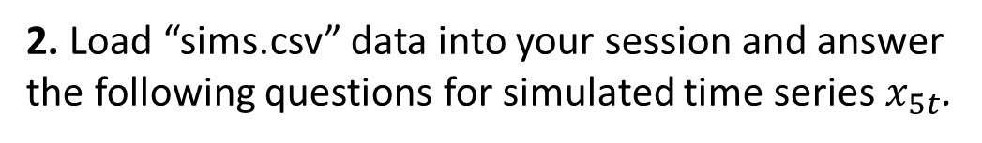
Practice Problems
2. Load “sims.csv” data into your session and answer the following questions for simulated time series $x_{5t}$.
a. Graph a time plot and explain whether the time series is stationary or not.
b. Perform linear regression and graph a histogram for model residuals, then comment on their distribution.
c. Explain what transformation could resolve non-stationarity if exist.
d. Perform Box-Cox transformation and a report value for lambda that works best for transforming this data.
e. Apply the suggested transformation, graph a new time plot for the transformed series, comment whether the issue is resolved.
f. Graph a decomposition plot and comment on each component of the plot.
3. Repeat the same steps for $x_{6t}$in “sims.csv” dataset.

